Slide 1
HR
Analytics
Prantik Singh Chauhan
Bhavya Samhitha Mallineni
Rajiya Proddatur
Neha
Swikriti Das
Rajiya Proddatur

Slide 2

HRWorks Pvt Ltd
About
Challenges
HRWorks Pvt Ltd is a Bangalore based start-up based on end-to-end Talent Acquisition Solution.
30% of the candidates who accept the job offer do not join the company which results in huge loss of revenue and time.
The organization spends tremendous amount of time and energy to recruit new talent. One of the major challenges for HR Works and its clients revolved around managing a quality workforce.
70%
30%
Joined
Not Joined
HR works needs to find a unique solution that goes beyond the process of HR management.

Slide 3
Approach to the Problem
Our aim is to analyze the data and build the best model which can predict the likelihood of the candidate joining.
Data Manipulation and Statistics
Visualization
EDA
ML Model Building
And ETL
If we can identify the candidates status in advance, then companies don’t have to waste their resources.
AWS and
Model Deployment

Slide 4
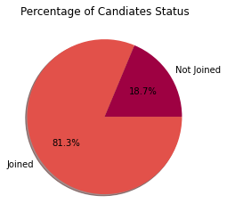
Data Description and Analysis
The data set has all the information about candidates who were previously offered the job and their joining status.
It consists of a mix of categorical and numerical data.
Handling Missing Values
Handling Outliers
The data had missing values in Age and Offered band.
To missing values were managed by replacing them with median and mode respectively.
Using Interquartile ranges (IQR) we treated the outliers.
Higher outliers were treated to get it at 95 percentile value and Lower outliers were treated to get it at 5 percentile value

Slide 5
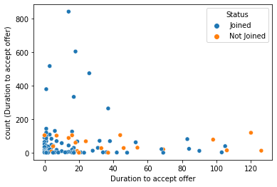
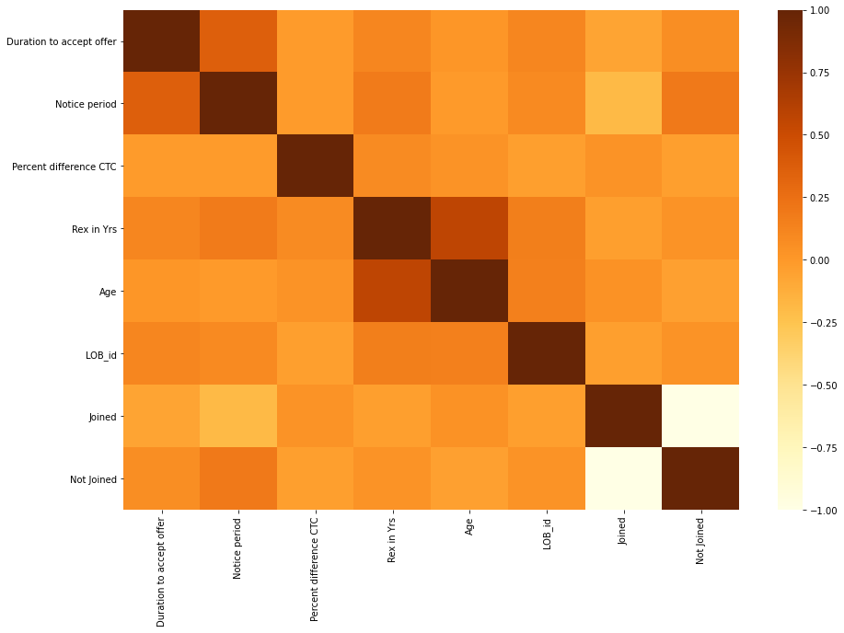
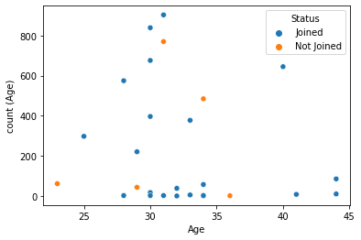
Numerical Data Analysis
Correlation Plot

Slide 6
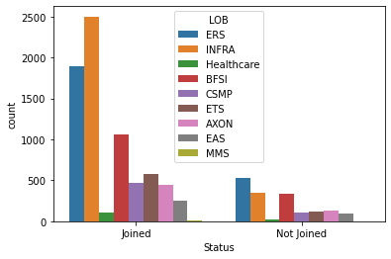
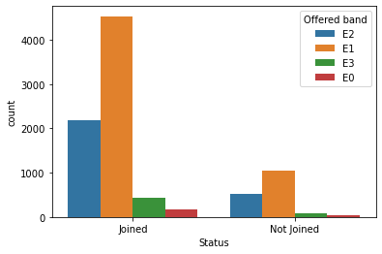
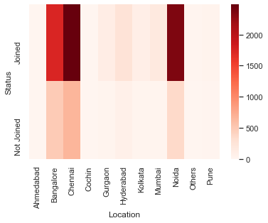
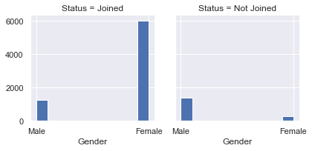
Categorical Data Analysis

Slide 7
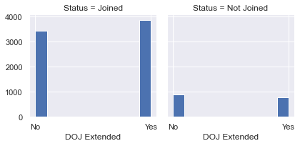
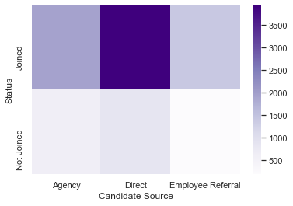
Data Transformation
This categorical data is converted to numerical data using :
Label encoding
One-Hot encoding.

Slide 8
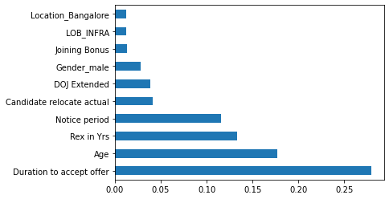
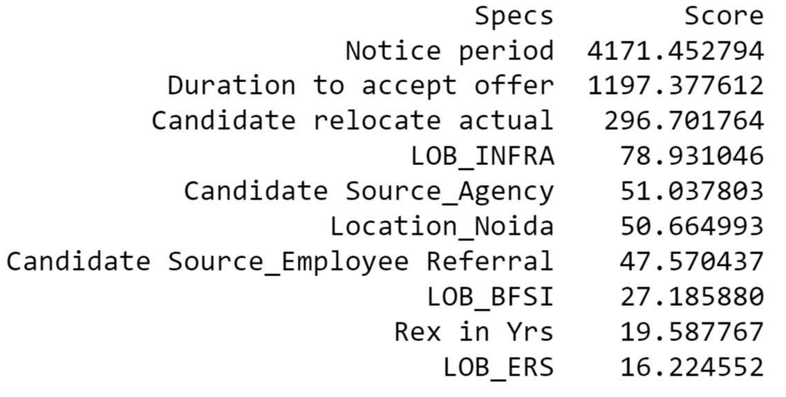
Feature Engineering
Feature Selection:- Statistical tests are used to select features that have strongest relationship with the output variable.
Feature Importance:- Gives the top important or relevant features to the output feature.
Feature Scaling
Data scaling rescales the features such that they have properties of standard normal distribution with mean of zero and a standard deviation of one

Slide 9
Machine Learning Algorithms and Model Building
Testing Data
Prediction
Model
Data
Training Data
Algorithm
Evaluation
Client Data

Slide 10
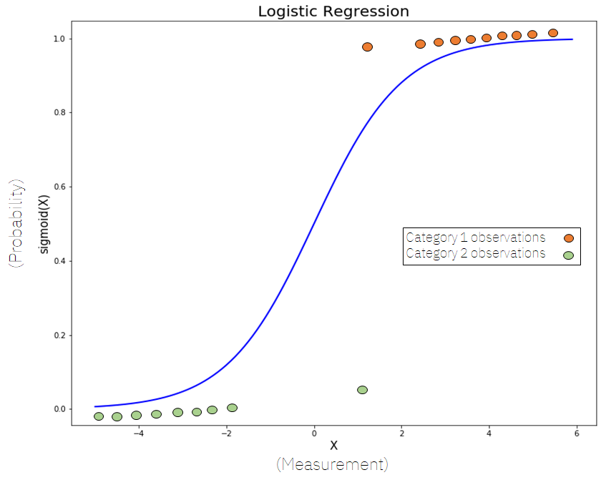
Logistic Regression
Logistic Regression is used to get relations between one or several independent variables with the dependent variable.
76%
81%
74%
81.2%
Precision
Recall
F1Score
Accuracy

Slide 11
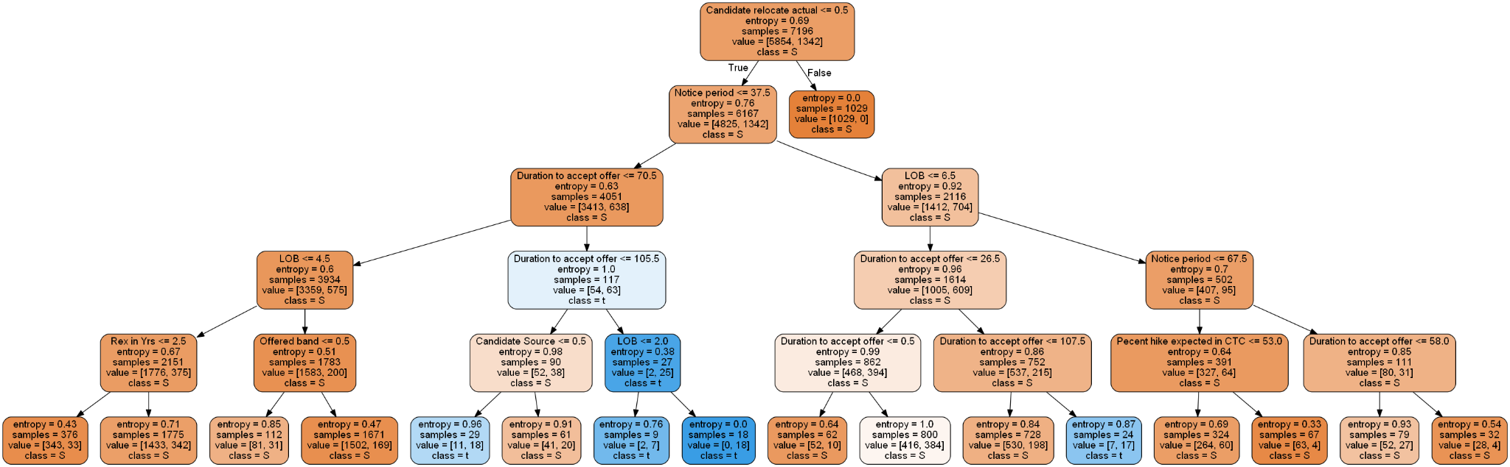
Decision Tree
78%
81%
74%
81.3%
Precision
Recall
F1Score
Accuracy

Slide 12
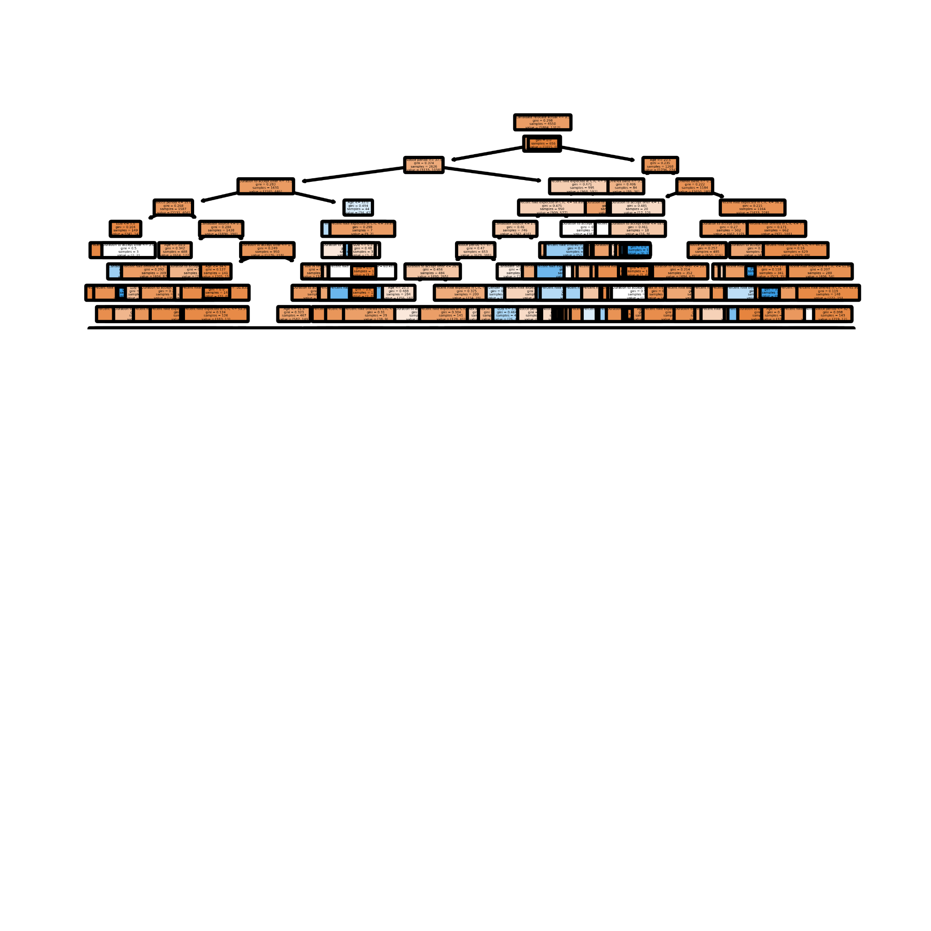
Random Forest Tree
78%
82%
78%
81.8%
Precision
Recall
F1Score
Accuracy

Slide 13
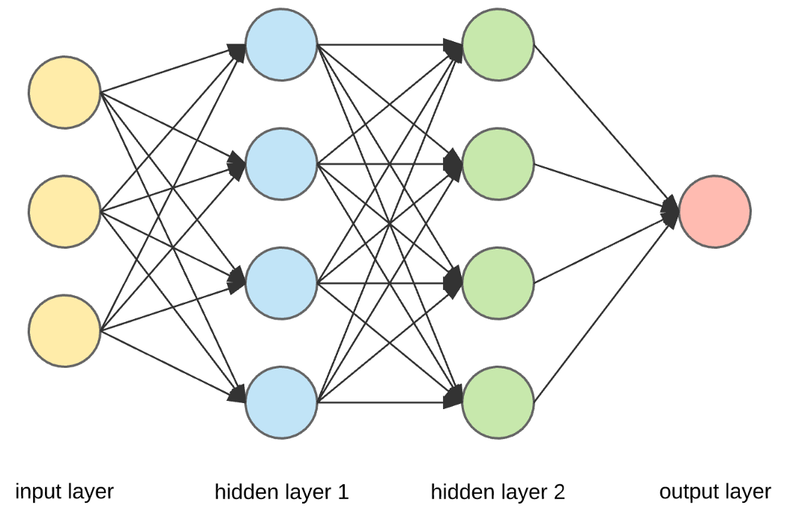
Artificial Neural Network
ANN is a deep learning method that mimics the learning technique of a human brain and behave like a human brain to some extent.
81.8%
Accuracy

Slide 14
ML Model Building
Random Forest
81.88%
Artificial Neural Network
Decision Tree
81.2%
81.32%
Logistic Regression
Since, prediction accuracy and F1 Score of Random Forest is better than our other models we have chosen that as our final model
81.2%

Slide 15
Data Analysis using Big Data Tools
Hadoop
Hive
It is a data warehouse infrastructure tool to process structured data in Hadoop
It is open source framework allows processing of large datasets
BIG DATA
Tools
PySpark
PySpark MLlib
It is used to analyse data in a distributed environment
Machine learning library which is built on top of spark to do data analysis

Slide 16
Data Analysis On Cloud
AWS
S3
RedShift
Athena
A S3 Bucket was created and our data was uploaded in it. From this bucket the data was loaded to redshift and athena by creating tables. Redshift is linked to PowerBI, which helps in BI analytics.
DataLake

Slide 17
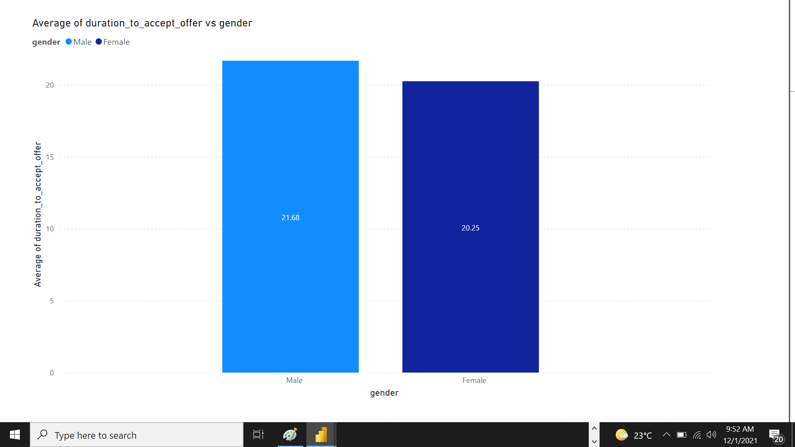
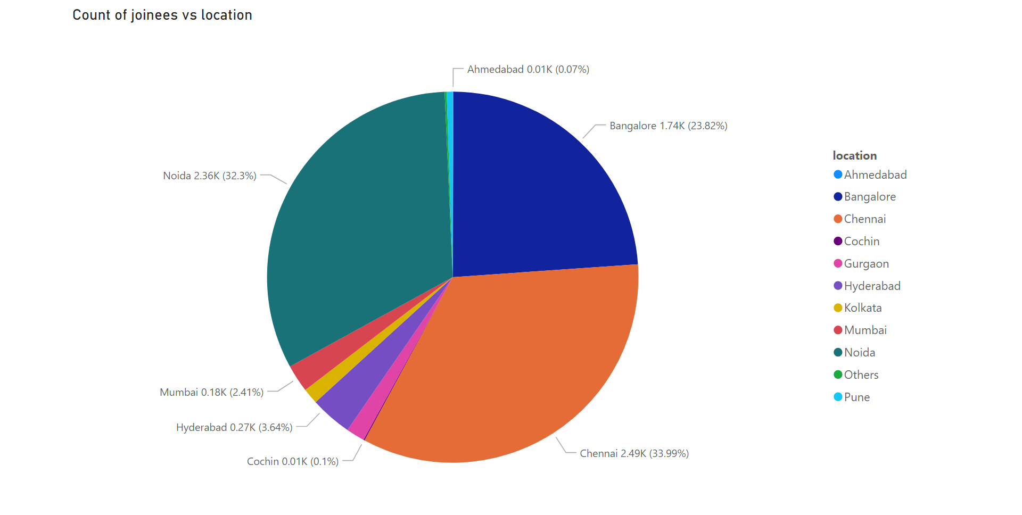
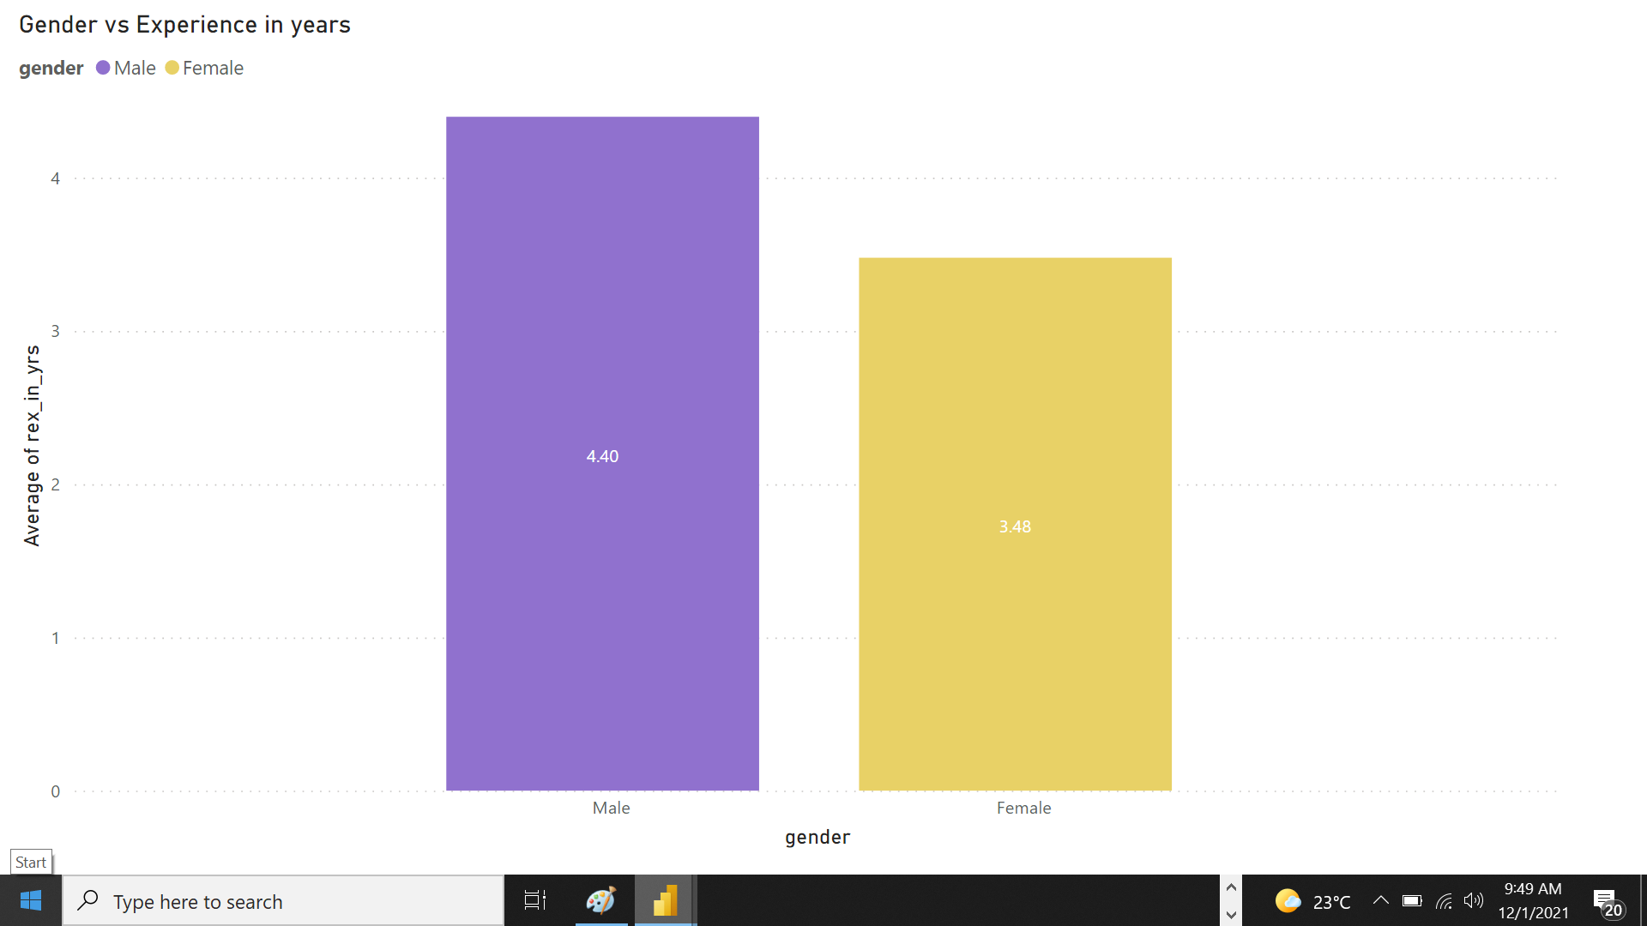
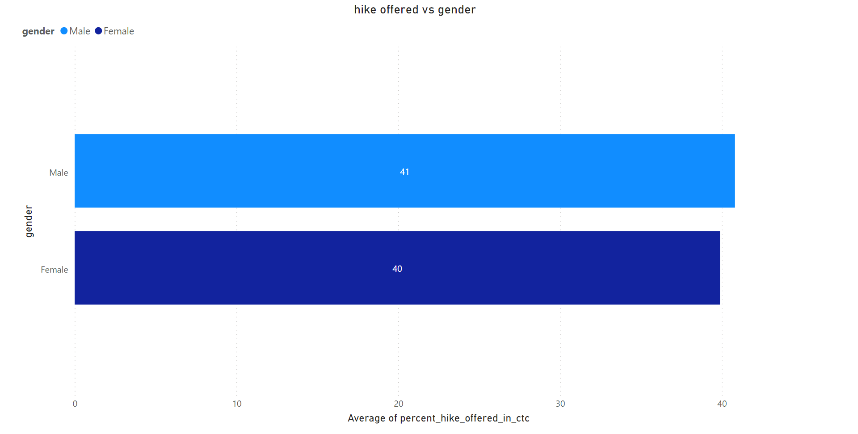
BI analysis on Cloud using PowerBI

Slide 18
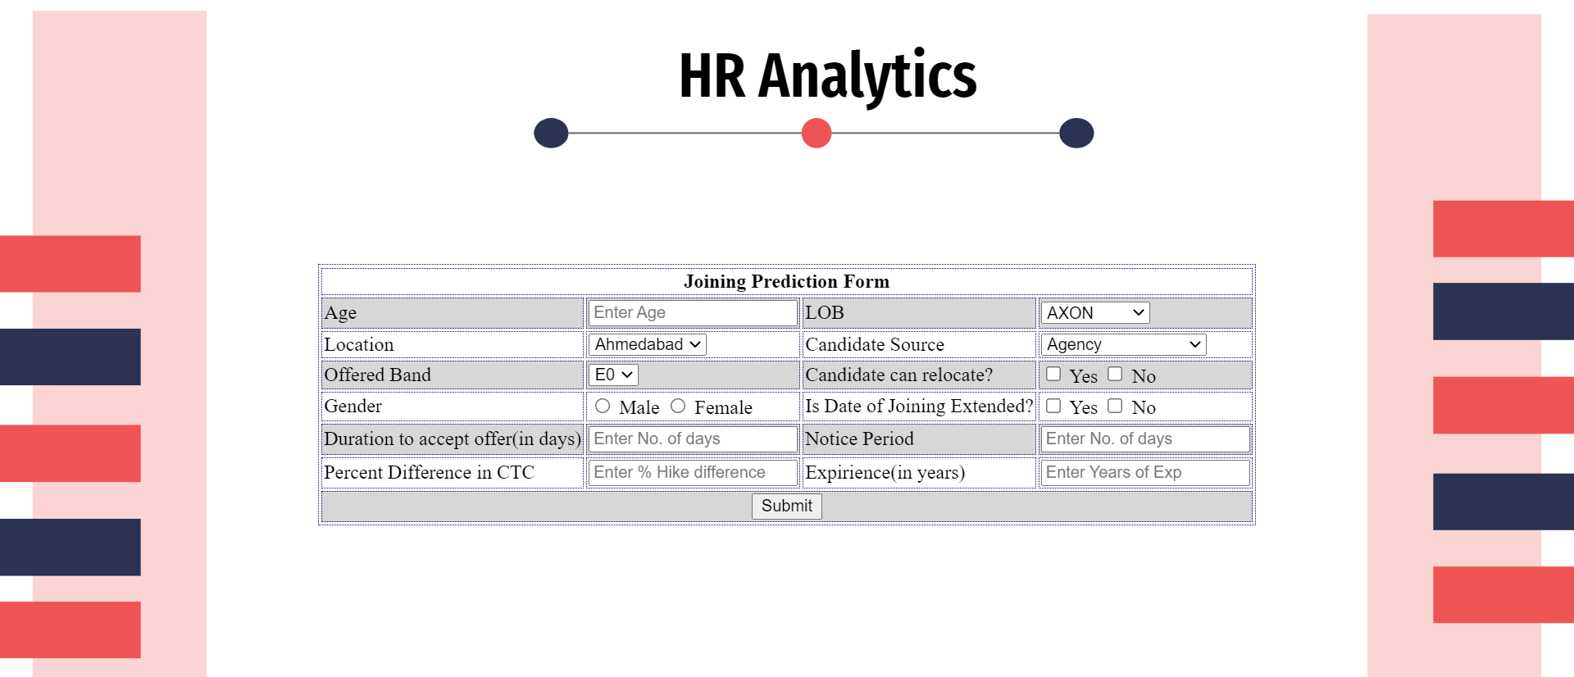
Deployment of ML Model

Slide 19


Slide 20
Conclusion
Based on the data of the candidates who were offered the job previously we built a web application that can predict a candidates joining status.
The predictive model was built using the random forest classifier having an accuracy of 81.88%
This model was deployed to make a web application with the help of flask.
This web application will enable the clients to invest on the candidates who are more likely to join.
It will also save them from spending their resources on candidates who will not be joining.

Slide 21
Thank You

